Slide 1
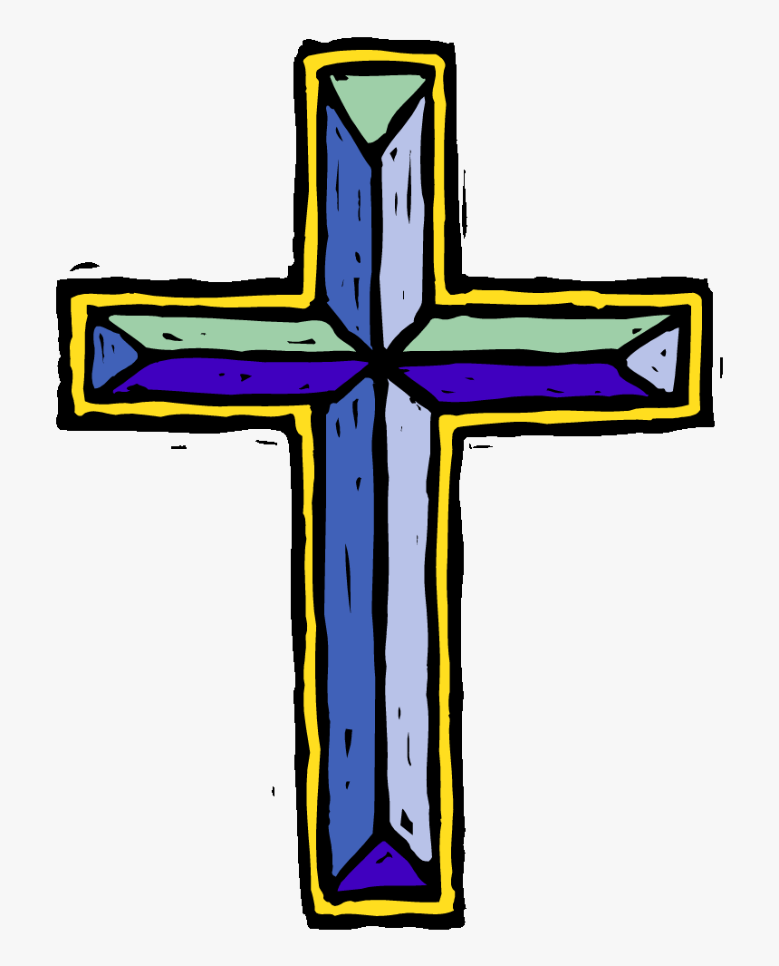

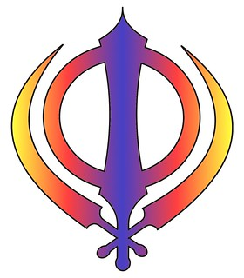

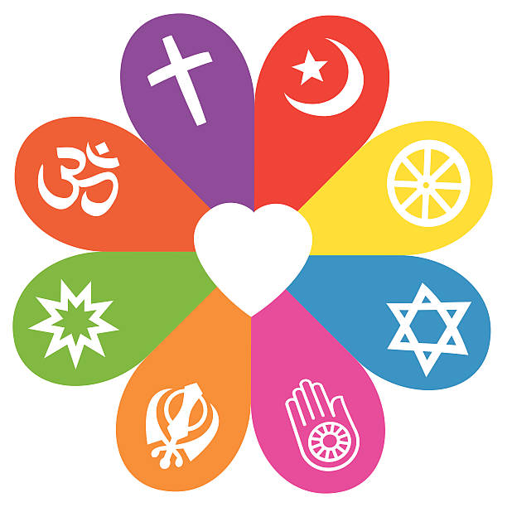
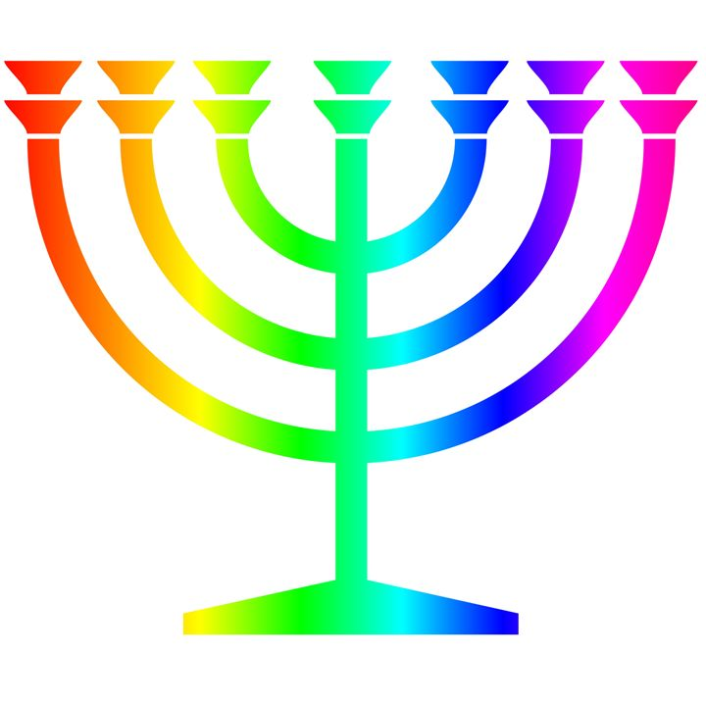
Autumn
What does it mean if God is holy and loving?
Christians believe God is omnipotent, omniscient and eternal, and that this means God is worth worshipping.
Christians believe God is both holy and loving, and Christians have to balance ideas of God being angered by sin and injustice (see Fall) but also loving, forgiving, and full of grace.
Christians do not all agree about what God is like, but try to follow his path, as they see it in the Bible or through Church teaching.
Christians believe getting to know God is like getting to know a person rather than learning information.
Was Jesus the Messiah?
Jesus was Jewish and Christians see Jesus as their saviour.
Christians believe Jesus is God in the flesh.
They believe that his birth, life, death and resurrection were part of a longer plan by God to restore the relationship between humans and God.
The Old Testament talks about a ‘rescuer’ or ‘anointed one’ — a messiah. Some texts talk about what this ‘messiah’ would be like.
Christians believe that Jesus fulfilled these expectations, and that he is the Messiah. (Jewish people do not think Jesus is the Messiah.)
RE Learning Journey Year 6
Spring
What would Jesus do?
The good news is not just about setting an example for good behaviour and challenging bad behaviour: it is that Jesus offers a way to heal the damage done by human sin.
Christians see that Jesus’ teachings and example cut across expectations — the Sermon on the Mount is an example of this, where Jesus’ values favour serving the weak and vulnerable, not making people comfortable.
Christians believe that they should bring this good news to life in the world in different ways, within their church family, in their personal lives, with family, with their neighbours, in the local, national and global community.
Why difference does the resurrection make for Christians?
Christians read the ‘big story’ of the Bible as pointing out the need for God to save people. This salvation includes the ongoing restoration of humans’ relationship with God.
The Gospels give accounts of Jesus’ death and resurrection.
Belief in Jesus’ resurrection confirms to Christians that Jesus is the incarnate Son of God, but also that death is not the end.
This belief gives Christians hope for life with God, starting now and continuing in a new life (heaven).
Understanding Christianity
Non-Christian faith
Comparing beliefs and practices
Summer
What does it mean for Muslims to follow God?
About Muslim beliefs about God, the Prophet and the Holy Qur’an.
About the five pillars and how these affect the lives of Muslims, moment by moment, daily, annually, in a lifetime.
How Muslims put the words of the Quran and the words and actions of the Prophet into practice, and what difference this makes to the lives of Muslims.
About the design and purpose of mosques.

