Slide 1
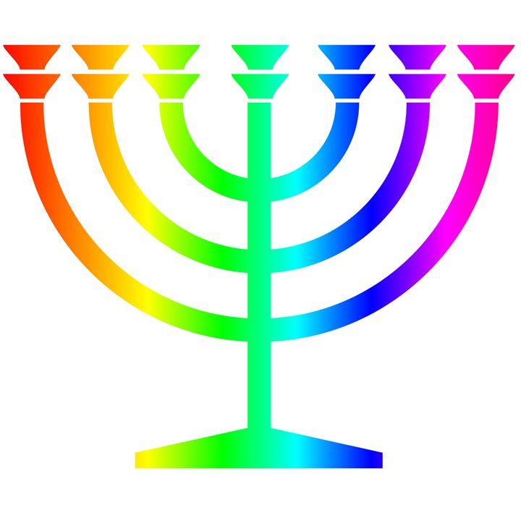
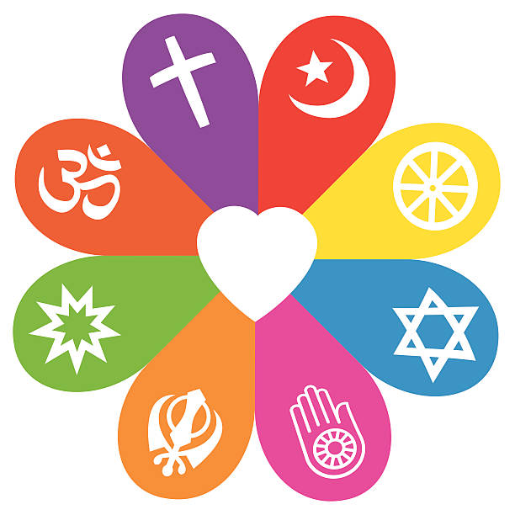
Autumn
Creation and science: conflicting or complimentary?
There is much debate and some controversy around the relationship between the accounts of creation in Genesis and contemporary scientific accounts.
These debates and controversies relate to the purpose and interpretation of the texts. For example, does reading Genesis as a poetic account conflict with scientific accounts?
There are many scientists throughout history and now who are Christians.
The discoveries of science make Christians wonder even more about the power and majesty of the Creator.
How can following God bring freedom and justice?
The Old Testament pieces together the story of the People of God.
The story of Moses and the Exodus shows how God rescued his people from slavery in Egypt; Christians see this story as looking forward to how Jesus’ death and resurrection also rescue people from slavery to sin.
Christians apply this idea to living today by trying to serve God and to bring freedom to others; for example, loving others, caring for them, bringing health, food, justice, and telling the story of Jesus
RE Learning Journey Year 5
Spring
How do religions help people through good times and bad times?
How religions guide people in how to respond to good and hard times in life.
Beliefs about life after death in at least two religious traditions and how they are similar/different.
That religious belief will affect how people respond to life’
What did Jesus do to save human beings?
Christians read the ‘big story’ of the Bible as pointing out the need for God to save people. This salvation includes the ongoing restoration of humans’ relationship with God.
The Gospels give accounts of Jesus’ death and resurrection.
The New Testament says that Jesus’ death was somehow ‘for us’. Christians interpret this in a variety of ways: for example, as a sacrifice for sin; as a victory over sin, death and the devil; paying the punishment as a substitute for everyone’s sins; rescuing the lost and leading them to God; leading from darkness to light.
Christians remember Jesus’ sacrifice through the service of Holy Communion (also called the Lord’s Supper, the Eucharist or the Mass).
Christians believe that Jesus calls them to sacrifice their own needs to the needs of others, and some are prepared to die for others and for their faith.
Understanding Christianity
Non-Christian faith
Comparing beliefs and practices
Summer
What kind of king is Jesus?
Jesus told many parables about the Kingdom of God. These suggest that God’s rule has begun, through the life, teaching and example of Jesus, and subsequently through the lives of Christians who live in obedience to God.
The Kingdom is compared to a feast where all are invited to join in. Not everyone chooses to do so.
Many Christians try to extend the Kingdom of God by challenging unjust social structures in their locality and in the world.
Why is pilgrimage important to some religious believers?
Some of the beliefs that lie behind places and times of pilgrimage in at least two religions.
How stories that lie behind sites of pilgrimage connect with beliefs.
The spiritual significance and impact of pilgrimage on pilgrims in at least two religions.
What happens during pilgrimages – sights, sounds, practices and the beliefs that lie behind them.

