Slide 1
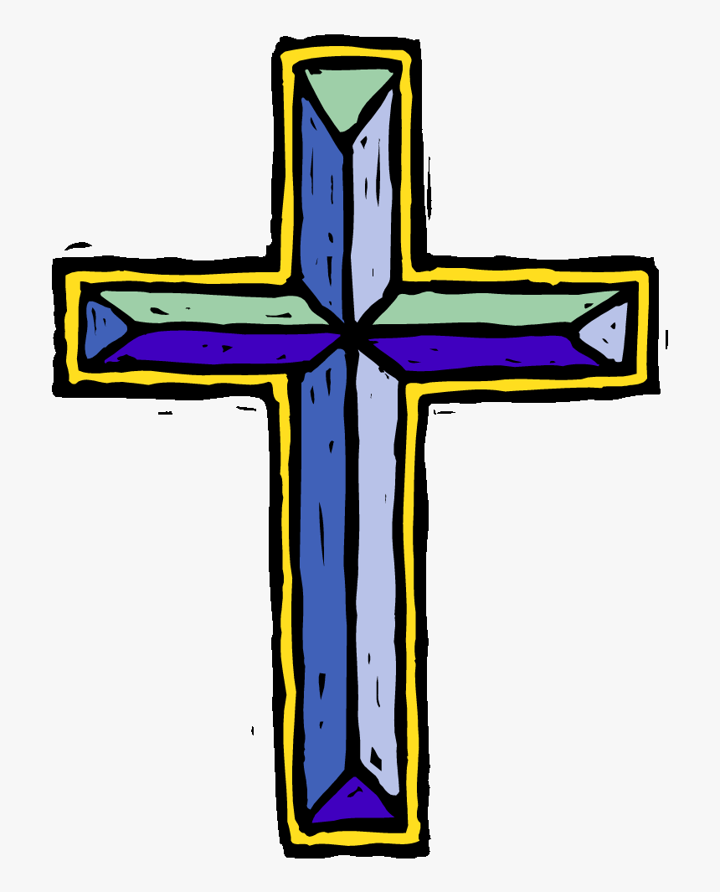
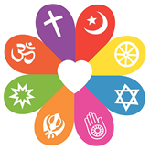
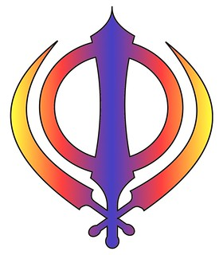
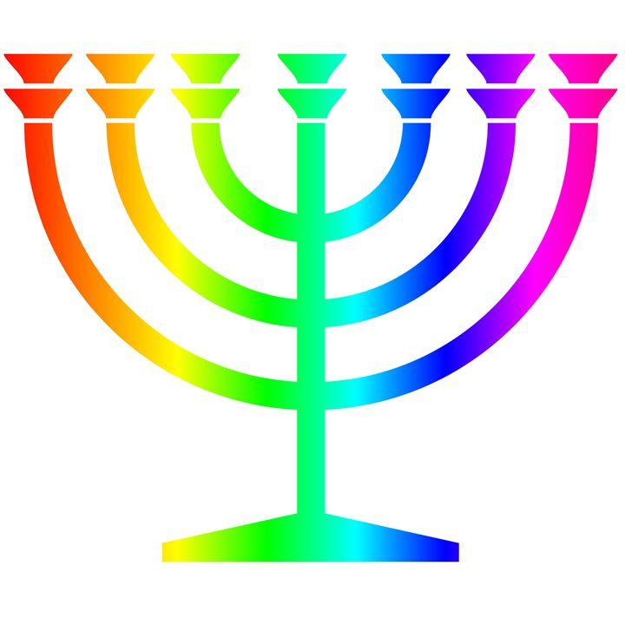
Autumn
What kind of world did Jesus want?
Christians believe Jesus challenges everyone about how to live — he sets the example for loving God and your neighbour, putting others first.
Jesus shows love and forgiveness to unlikely people.
Christians try to be like Jesus — they want to know him better and better.
Christians try to put his teaching and example into practice in lots of ways, from church worship to social justice.
What is the Trinity? (Digging deeper)
Christians believe God is Trinity: Father, Son and Holy Spirit.
Christians believe The Father creates; he sends the Son who saves his people; the Son sends the Holy Spirit to his followers.
Christians find that understanding God is challenging; people spend their whole lives learning more and more about God.
Christians really want to try to understand God better and so try to describe God using symbols, similes and metaphors, in song, story, poems and art.
Christians worship God as Trinity. It is a huge idea to grasp and Christians have created art to help to express this belief.
Christians believe the Holy Spirit is God’s power at work in the world and in their lives today, enabling them to follow Jesus.
RE Learning Journey Year 4
Spring
What are the deeper meanings of festivals?
About two/three festivals from different religions and the meanings of stories behind them.
About how believers express the meanings of festivals through symbols, sounds, actions, story and rituals.
About the benefits of celebration to religious communities.
Why do Christians call the day Jesus died Good Friday? (Digging deeper)
Christians see Holy Week as the culmination of Jesus’ earthly life, leading to his death and resurrection.
The various events of Holy Week, such as the Last Supper, were important in showing the disciples what Jesus came to earth to do.
Christians today trust that Jesus really did rise from the dead, and so is still alive today.
Christians remember and celebrate Jesus’ last week, death and resurrection
Understanding Christianity
Non-Christian faith
Comparing beliefs and practices
Summer
When Jesus left what was the impact of Pentecost?
Christians believe that Jesus inaugurated the ‘Kingdom of God’ — i.e. Jesus’ whole life was a demonstration of his belief that God is King, not just in heaven but here and now.
Christians believe Jesus is still alive, and rules in their hearts and lives by the Holy Spirit, if they let him.
Christians believe that after Jesus returned to be with God the Father, he sent the Holy Spirit at Pentecost to help the Church to make Jesus’ invisible Kingdom visible by living lives that reflect the love of God.
Christians celebrate Pentecost as the beginning of the Church
How and why do believers show their commitments during the journey of life?
Some beliefs about love, commitment and promises in two religious traditions and describe what they mean.
About the meaning and importance of ceremonies of commitment for religious and non-religious people today.
What happens in ceremonies of commitment and what associated rituals mean?
Differences between commitment celebrations in different religions.

