Slide 1

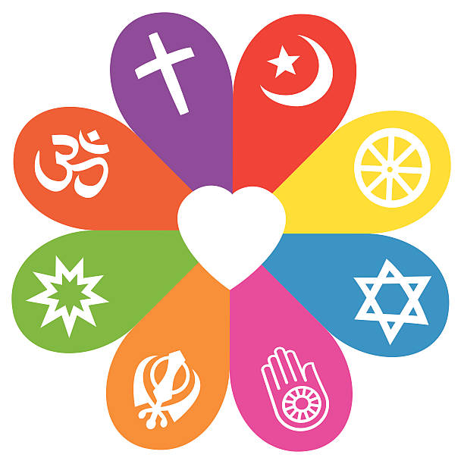


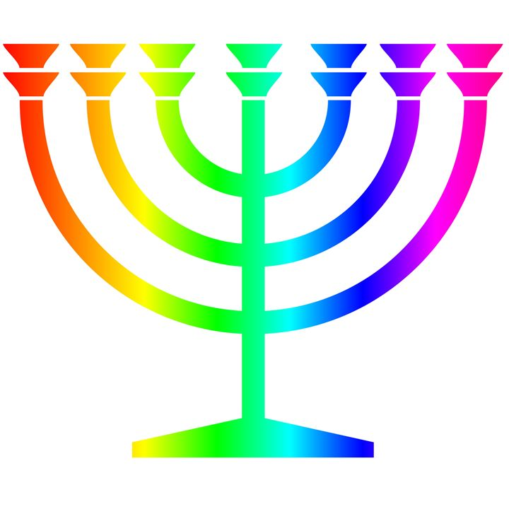

RE Learning Journey Year 2
Autumn
How should we care for others and why does it matter?
In many religions a key belief is that God loves all people.
Christians, Muslims and Jews try to follow the ‘golden rule’ (Care for others.)
People of faith (and none) show that they care for others (e.g. by giving to charity).
Learn about the creation story in Genesis 1 and that this tells Christians and Jewish people that they must care for the world.
People of different faiths (and none) believe that it is important to look after the natural world.
Why does Christmas matter to Christians? (Digging Deeper)
Christians believe that Jesus is God and that he was born as a baby in Bethlehem.
The Bible points out that his birth showed that he was extraordinary (for example, he is worshipped as a king, in Matthew) and that he came to bring good news (for example, to the poor, in Luke).
Christians celebrate Jesus’ birth; Advent for Christians is a time of getting ready for Jesus’ coming.
Spring
What is the good news that Jesus brings?
Christians believe Jesus brings good news for all people.
For Christians, this good news includes being loved by God, and being forgiven for bad things.
Christians believe Jesus is a friend to the poor and friendless.
Christians believe Jesus’ teachings make people think hard about how to live and show them the right way.
Why does Easter matter to Christians? (Digging deeper)
Easter is very important in the ‘big story’ of the Bible.
Christians believe Jesus rose again, giving people hope of a new life.
Understanding Christianity
Non-Christian faith
Comparing beliefs and practices
Summer
Who makes some places sacred to believers?
Some people go to special places to worship.
What happens in places of worship and the significance of some stories, objects, symbols and actions.

