Slide 1

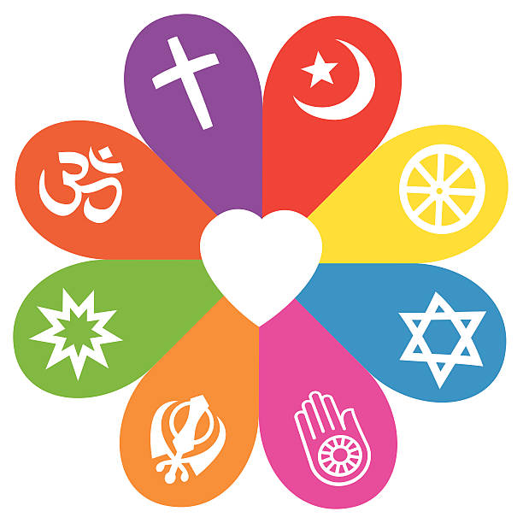
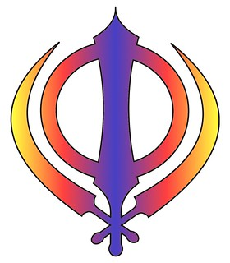

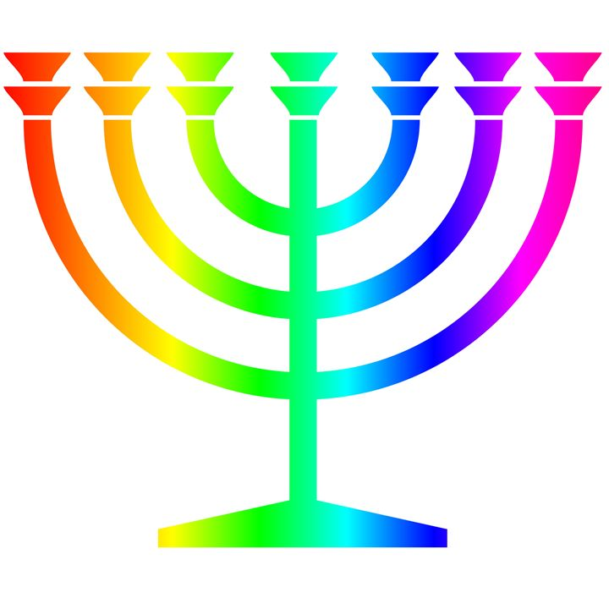
Autumn
Who made the world?
God created the universe.
The Earth and everything in it are important to God.
God has a unique relationship with human beings as their Creator and Sustainer.
Humans should care for the world because it belongs to God.
Why does Christmas matter to Christians?
Christians believe that Jesus is God and that he was born as a baby in Bethlehem.
The Bible points out that his birth showed that he was extraordinary (for example, he is worshipped as a king, in Matthew) and that he came to bring good news (for example, to the poor, in Luke).
Christians celebrate Jesus’ birth; Advent for Christians is a time of getting ready for Jesus’ coming.
RE Learning Journey Year 1
Spring
What do Christians believe God is like?
Christians believe in God, and that they find out about God in the Bible.
Christians believe God is loving, kind, fair and forgiving, and also Lord and King. Some stories show these Christian beliefs.
Christians worship God and try to live in ways that please him.
Why does Easter matter to Christians?
Easter is very important in the ‘big story’ of the Bible.
Christians believe Jesus rose again, giving people hope of a new life.
Understanding Christianity
Non-Christian faith
Comparing beliefs and practices
Summer
Who is Jewish and how do they live? Who am I? What does it mean to belong?
Jewish beliefs about God as expressed in the Shema. Loving others is important in lots of communities.
Some stories used in Jewish celebrations (e.g. Hannukah, Shabbat and Sukkot) What happens at welcome and marriage ceremonies in different faiths
and what the actions and symbols mean.
How Jewish people celebrate special times.
How people express their identity in belonging within faith/non-faith
How Jewish ideas of God impacts upon how Jewish people live. communities.

