Slide 1



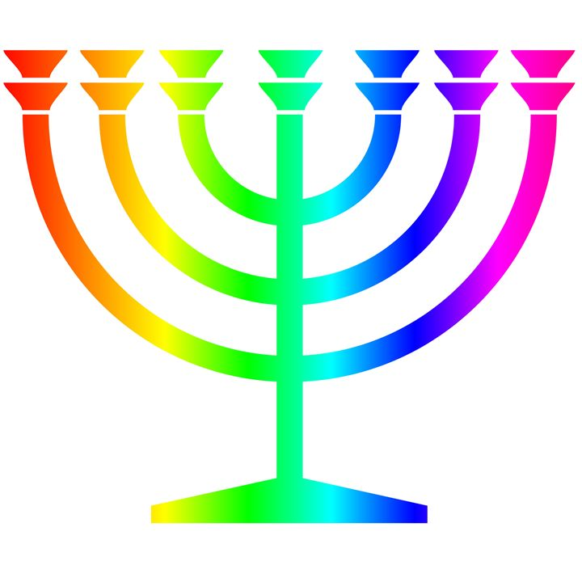
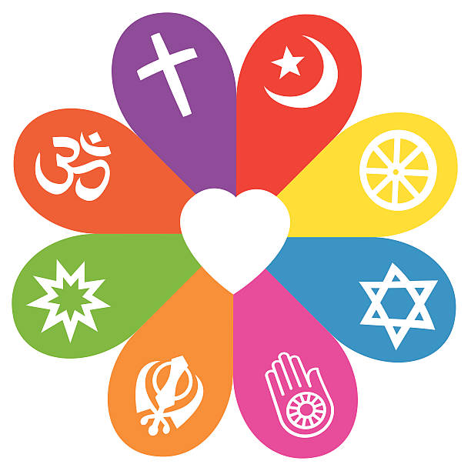








Year 6 | What does it mean if God is holy and loving? |  |  |  | Was Jesus the Messiah? | What would Jesus do? | What difference does the resurrection make for Christians? |  | What does it mean for Muslims to follow God?
Year 5 |  | Creation and science: conflicting or complimentary? | Creation and science: conflicting or complimentary? | How can following God bring freedom and justice? |  |  | What did Jesus do to save human beings? | What kind of king is Jesus? |  | 1) Why is pilgrimage important? 2) How religion helps people through good and bad.
Year 4 |  |  |  |  | What is the Trinity? (Digging deeper) | What kind of world did Jesus want? | Why do Christians call it ‘Good Friday’? (Digging deeper) | When Jesus left what was the impact of Pentecost? |  | 1)Deeper meanings of festivals. How/why do believers show commitment?
Year 3 | What do Christians learn from the creation story? |  |  | What is it like to follow God? | What is the Trinity? |  | Why do Christians call it ‘Good Friday’? |  | What does it mean to be a Sikh in Britain today?
Year 2 |  |  |  |  | Why does Christmas matter to Christians? (Digging deeper) | What is the good news that Jesus brings? | Why does Easter matter to Christians? (Digging deeper) |  |  | 1)How should we care for others? 2)What makes some places sacred?
Year 1 | What do Christians believe God is like? | Who made the world? |  |  | Why does Christmas matter to Christians? |  | Why does Easter matter to Christians? |  | Who is Jewish and how do they live? | Who am I? What does it mean to belong?
Reception | Why is the word God so important to Christians? |  |  |  | Why do Christians perform nativity plays? |  |  |  |  | 1) Being special. 2) Which places are special? 3) Which stories are special?
 | God | Creation | Fall | People of God | Incarnation | Gospel | Salvation | Kingdom of God
Understanding Christianity |  |  |  |  |  |  |  |  | Non- Christian | Thematic

